Slide 1
Frontend Development
A friendly introduction
Gilly Barr, 04/2020
Notes:
A few notes about me (Gilly Barr) if you’re interested -
I’ve been building websites with php since I was 13.
Was in the air force as a .net programmer (mostly microsoft technologies)
Worked at Visa CAL for 2.5 years.
Sears Israel for 3 years - Started doing mainly frontend here!
First employee at logz.io and was lead the frontend team. (3 years)
Now at Google for the past 2 years and counting...

Slide 2
Agenda
 | The browser & how it works HTML CSS Javascript Cookies AJAX
 | Frameworks & Libraries What, Which & Why Overview of React Demo DevTools - some tips and tricks

Slide 3
Proprietary + Confidential
The browser & how it works

Slide 4
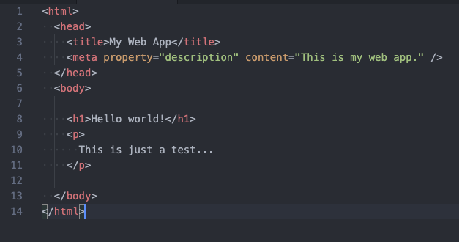
HTML
Defines the structure of your content.
Built from different elements.
Each element has a semantic meaning.
Each element can have many attributes.
Elements can be nested.
Notes:
Every (most) elements need a closing tag, or need to be “self closing” (like ‘meta’)
All tags need to close opposite the order they were opened in (like a stack - FILO)
Each element has a name - the first part of the element
a list of attributes (with values or without)
and a body (which can contain more elements, or just text)

Slide 5
HTML Elements
Headings | <h1>Main heading</h1> h1 .. h6 Are used for different headers
Text | <p>for paragraphs</p> <b>Bold text</b>
Links | <a href=”http://google.com”>Go to Google</a>
Lists | <ul> <li>first</li> <li>second</li> </ul>
Span/Div | <span>Used to separate inline text</span> <div>This is a section on the page</div>
Notes:
h1..h6 Are used for headings.
p - paragraph
span - to style a specific part of text
a - links (or anchors)
ul - unordered lists
div - division (an area on the page)
meta - for describing the page
img - to display images
svg - for graphics
::before, ::after - “psuedo elements”

Slide 6
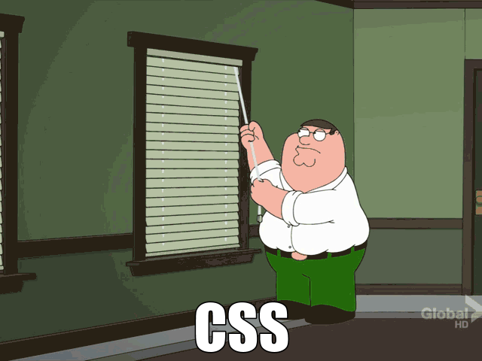
CSS
Defines how the elements will be displayed.
Using CSS selectors you define a group of elements, and define a specific style to that group (usually using ‘classes’).
Not all browsers behave the same (css reset).
Many frameworks have been built above CSS to make life easier (sass, scss, less, etc)
Notes:
(from my experience) many people don’t *really* understand how CSS works...
Once you understand the basic concepts, it will be really easy!
“css reset” are usually a small css file that websites include in the beginning of the css files that make sure all basic styles are the same across browsers.
When you use a CSS framework, this is usually added for you.

Slide 7
CSS Selectors
span - all span elements .my-class - all elements with class=”my-class” span.my-class - all span elements with class=”my-class” #element-id - elements with id=”element-id” (should be one!) .first-class.second-class - all elements that have both classes .first-class .nested-element-class - all elements that have the class ‘nested-element-class’ that are inside an element with the class ‘first-class’ .some-class > .direct-sibling - elements with ‘direct-sibling’ that are an immediate child of elements with the class ‘some-class’
input[type=”button”] - All input elements that have attribute type=’button’
Additions :hover - Specific style for when the mouse is hovering over :first-child, :last-child, :nth-child(n)
span.title .sub-title { font-family: ‘Ariel’; font-size: 14px; text-decoration: underline; color: #ff00aa; }
Notes:
Full index of CSS selectors can be seen here:
https://developer.mozilla.org/en-US/docs/Web/CSS/CSS_Selectors
There’s also psuedo elements - ::before, ::after which create elements before and after they’re matching selector’s element
The format of a CSS file -
There are selectors, and then in brackets which styles effect those selectors.
Sizes in CSS can be ‘px’ ‘em’ ‘rem’ ‘%’ etc.
Colors are either rgb(<number>, <number>, <number>) or a a hex value like #aa00ff

Slide 8
CSS Selectors (continued)
Selectors that are present later in the css file override their previous definitions.
Unless they’re not specific enough..
There’s a scoring system (but I wouldn’t recommend counting on it).
You can also override selectors values, by adding ‘!important’ after the value.
.hidden { display: none !important; }
Notes:
Full index of CSS selectors can be seen here:
https://developer.mozilla.org/en-US/docs/Web/CSS/CSS_Selectors
Counting system:
Id’s have a high priority.
more classes raises priority
You can always override a value by adding ‘!important’ to the value.
I would use this carefully.

Slide 9


CSS Concepts
Media Queries
For specifying specific classes for specific screen sizes or resolutions (a.k.a. “Responsive design”).
@media only screen and (max-width: 800px) {
...
}
@media (orientation: landscape) {
...
}
Notes:
This is how we can address various screen sizes, orientations (landscape/portrait), print, resolution, and more…
It is very popular to override values in these selector groups, so in smaller resolutions we can hide
certain elements or make them smaller.

Slide 10
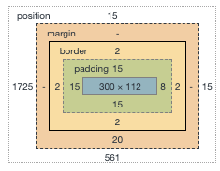
CSS Concepts (continued)
The box model |  | Inline vs. Block
Each CSS element is bounded by a rectangular box, that has a few layers to it. |  | Every element has a ‘display’ value. This can be ‘inline’, ‘block’ or ‘inline-block’. Inline elements are inlined in the regular flow of the text. Block elements take up the whole line. And ‘inline-block’ elements are inlined, but with some extra ‘block’ abilities.
Notes:
Each element has a bounding box.
border and padding are part of the element (relevant for clicking and maybe other events)
margin is not part of the element.
Inline vs. block (These are not the only values - there is also ‘none’ and more)
inlined elements don’t have padding or margins. They take up space by their size.
Block elements by default take up the whole line.

Slide 11
CSS Concepts (continued)
Position |  | Absolute vs. Fixed
Each element has a ‘position’ property. Usually not defined, but when we want to align something in a very specific position, we can use ‘absolute’ or ‘fixed’ |  | Fixed - relative to the browser window, regardless of scroll position or any other elements on the screen. Absolute - relative to the closest parent that has ‘position: relative;’ defined. Both of the above are defined by distance from: top, bottom, right or left.
Notes:
‘fixed’ is usually used when you want to display something on the top or bottom of the page even when the user scrolls.
Also good for displaying dialogs or messages you want the user to act on before continuing to the site.
(usually used for annoying paywalls as well!)
‘absolute’ is used more often, and for times when you want something to always be in a specific position inside it’s container.
Useful for aligning things to the bottom of a container, or to one of the corners.

Slide 12
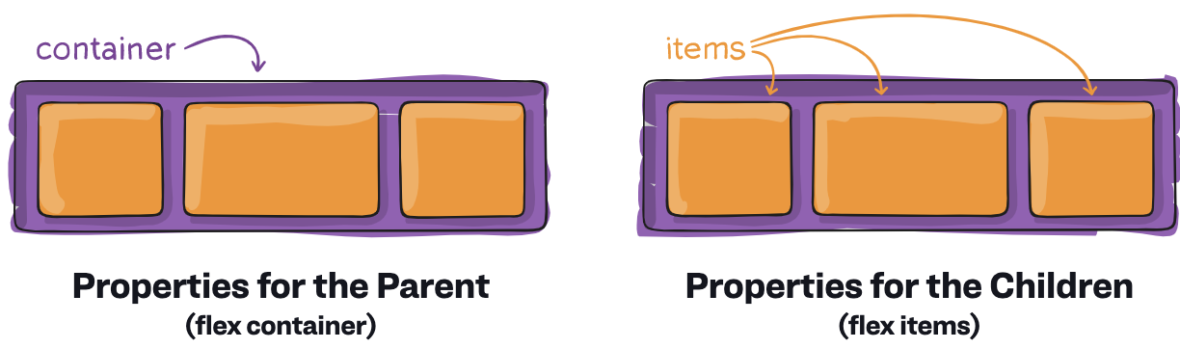
CSS Concepts (continued)
Flex |  |  |  | Properties
A container can be defined with ‘display: flex’ and then easily define the flow, spacing, order and alignment of all the ‘items’ inside the container. |  |  |  | flex-direction: row | column flex-grow: <number> justify-content: flex-start | flex-end | space-around | space-between order: <number>
Notes:
CSS Flex overview: https://css-tricks.com/snippets/css/a-guide-to-flexbox/
flex-direction - will align items below or to the side
flex-grow - will define how much space each item will take in it’s row
justify-content - how to space the items inside the container
order - Define the actual order of the items inside the container (not that popular)
Flex makes responsive design much easier!
Without flex you couldn’t really align items in the center vertically.
Flex is aware of the direction of the text - This is great for ‘rtl’ languages like hebrew.

Slide 13
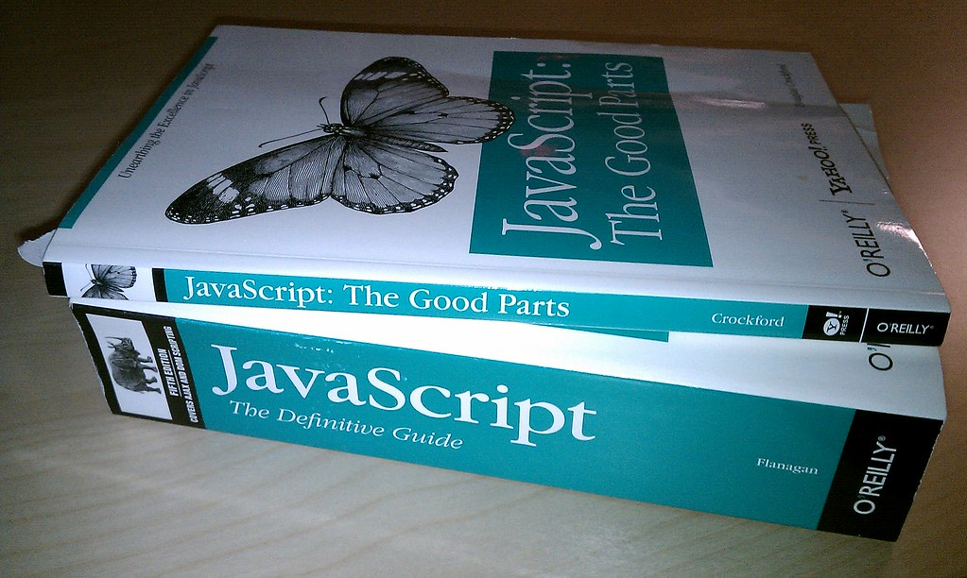
Javascript
Defines the behavior of our web page.
First version built in just 2 weeks!
Today JS is the most popular programming language in the world.
Runs on every browser, every mobile client, on the server (nodejs), desktop apps (electron), etc.
Each browser has its own interpreter.
Notes:
Javascript is the only programming language browsers ‘natively’ understand.
(There is WebAssembly, but it’s not mature yet, and not widely used).
Many other languages compile to javascript: CoffeeScript, Typescript, Elm, Dart, PureScript, ClojureScript, Kotlin, etc..
They’re ‘supersets’ of the language, and are eventually converted to javascript.
The language evolved a lot in recent years, with ES5 & ES6.
Not all browsers understand the newest specifications of the language, so there are polyfills and compilers like Babel and WebPack.

Slide 14

Javascript & the DOM (Document Object Model)
The web page structure is represented in memory as a tree - each element is a node in the tree. (The ‘<html>’ tag is the root)
Each node (element) in the tree can be accessed via javascript, and can be modified freely. We can create nodes, remove nodes, change attributes, edit styles, etc..
Notes:
The ‘document’ variable is a global variable that holds the whole DOM.
The image shows the html document converted to a tree of nodes. Each node has all the information it needs to be displayed and to react to different events.

Slide 15
Javascript & the DOM (Document Object Model)
Accessing nodes: document.getElementById(‘page-title’); document.getElementsByTagName(‘img’);
Modify elements styles: someElement.styles.fontSize = ‘14px’; someElement.styles.backgroundColor = ‘black’;
Create elements and adding them to the DOM: let newElement = document.createElement(‘div’); newElement.setAttribute(‘style’, ‘background-color: black’); document.getElementsByTagName(‘body’)[0] .appendChild(newElement);
Adding/Removing classes from elements: someElement.classList.add(‘new-class’); someElement.classList.remove(‘old-class’);
Notes:
These are just some basic examples.
Some of the more advanced stuff isn’t compatible across browsers, so you should use a framework for this.
jQuery takes care of all inconsistencies.

Slide 16
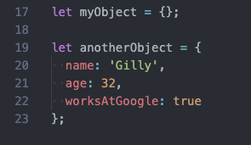
Javascript Concepts
Types |  | Objects
Javscript has: Number (& BigInt) String Boolean Symbol Object (Function, Array, Date, RegExp) null / undefined Defined with ‘let’ or ‘const’ |  | Almost everything is an ‘Object’ in javascript. All objects have a ‘prototype’ - This is similar to inheritance. Creating an object:
Notes:
Basic primitive types in javascript: Number, String, Boolean, Symbol
null and undefined are special types of variables.
Function, Array, Date, RegExp are special types of Object. They have specific properties and methods, but ‘inherit’ from ‘Object’
‘const’ to define variables that can’t be changed (immutable).
‘let’ to define variables that can be changed, and maintain value within their scope.
Almost everything ‘inherits’ from Object in javascript.
When creating an object in javascript, you can specify it’s ‘prototype’ (via ‘Object.setPrototypeOf’ ) to define ‘inheritance’.
(an object’s prototype used to be stored on the ‘__proto__’ property, but that’s not really defined in the spec).
Javscript doesn’t require the ‘new’ keyword (like other languages) when creating an object.
Defining an object without it is exactly the same.

Slide 17
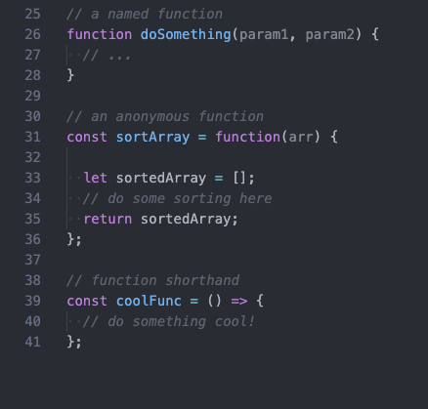
Javascript Concepts
Functions
Functions can be named or anonymous. You can pass a function as a value just by using its name, without invoking it. When passing functions around, you need to be aware of the use of ‘this’.. The shorthand version is widely used because of its simplicity and fixed the ‘this’ problem.
Notes:
Functions are first-class citizens in javascript.
They are used a lot, and passed around a lot. (after all, they’re just another type of ‘Object’)
A few different ways of writing functions, as seen in example.
The shorthand version defines ‘this’ inside the function differently than the others.

Slide 18
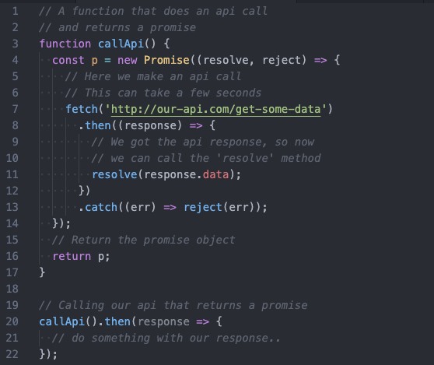
Javascript Concepts
Promises
A promise is an object that represents something that will happen in the future. Commonly used for actions that happen outside of the main js thread, like api requests. It has a then() method, and catch() method, which both receive a function as a parameter, that will be invoked when the promise is resolved.

Slide 19
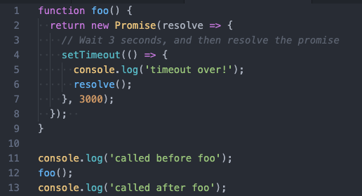
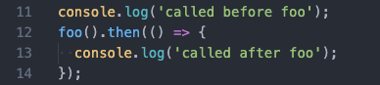
Javascript Concepts
Promises
> called before foo
> called after foo
> timeout over!
> called before foo
> timeout over!
> called after foo
Notes:
Here you can see the differences of using ‘then()’ and not using ‘then()’
and see when the output is printed to the console.
An important difference here is that:
In the first example there is a 3sec pause before the second and third statements
In the second example the 3sec pause is between the first and second statements.

Slide 20
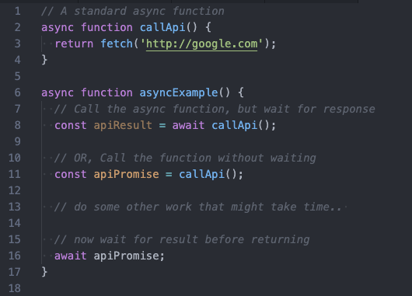
Javascript Concepts
async / await
An async function is a function that runs in a separate order than the rest of the code, and returns a promise. Calling await on the function, or the function’s result, will stop the code execution until the promise is resolved (or an error is thrown).
Notes:
await can only be used inside an ‘async’ function.
It basically converts async code to seem ‘linear’ - so it’s easier to read, but you need to understand the implications.
More information: https://developer.mozilla.org/en-US/docs/Learn/JavaScript/Asynchronous/Async_await

Slide 21
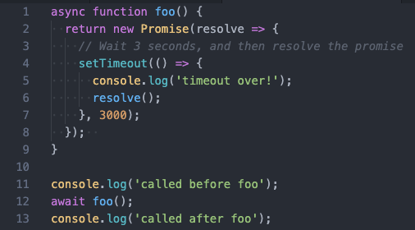
Javascript Concepts
async / await
> called before foo
> timeout over!
> called after foo
Notes:
Notice that the function is marked with ‘async’!
In this example, the ‘await’ will cause the code execution to stop, and wait for the promise returned from ‘foo()’ to be resolved before continuing.

Slide 22
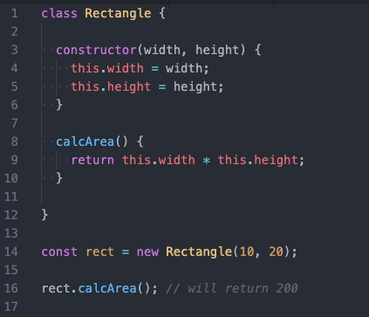
Javascript Concepts
Classes
A javascript class still has a prototype inheritance model under the hood. Can inherit from other classes using extend. Parent’s constructor are called with super()

Slide 23
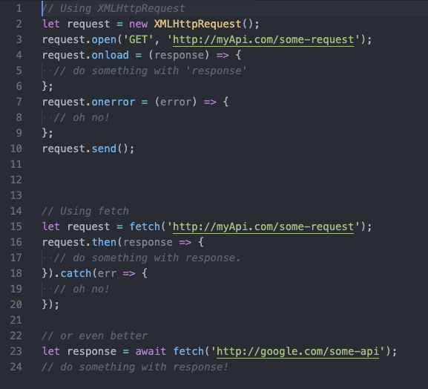
Javscript Concepts
XMLHttpRequest (a.k.a. AJAX / fetch)
An object that allows us to make calls to different web pages, api’s or resources.
fetch() is the modern api - much simpler to use and works with promises.
Note: Calling ‘fetch’ or using XMLHttpRequest doesn’t stop the rest of the code from running, so we need to pass it a function to invoke for when the response arrives.

Slide 24
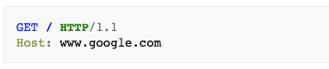

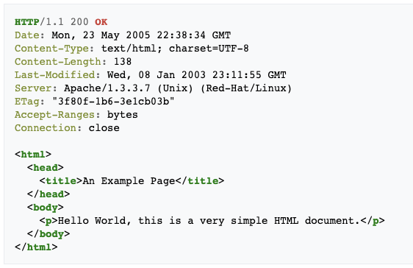
HTTP & REST
The web is based on the HTTP protocol (which is based on TCP)
Every call the browser makes is an HTTP request
Notes:
The web is based on the HTTP protocol.
Every request the browser makes is an HTTP request.
Each request has a “method” property - Typing a url in the browser is always converted to a ‘GET’ request.
The images on the right show how the raw http request and response look like.

Slide 25
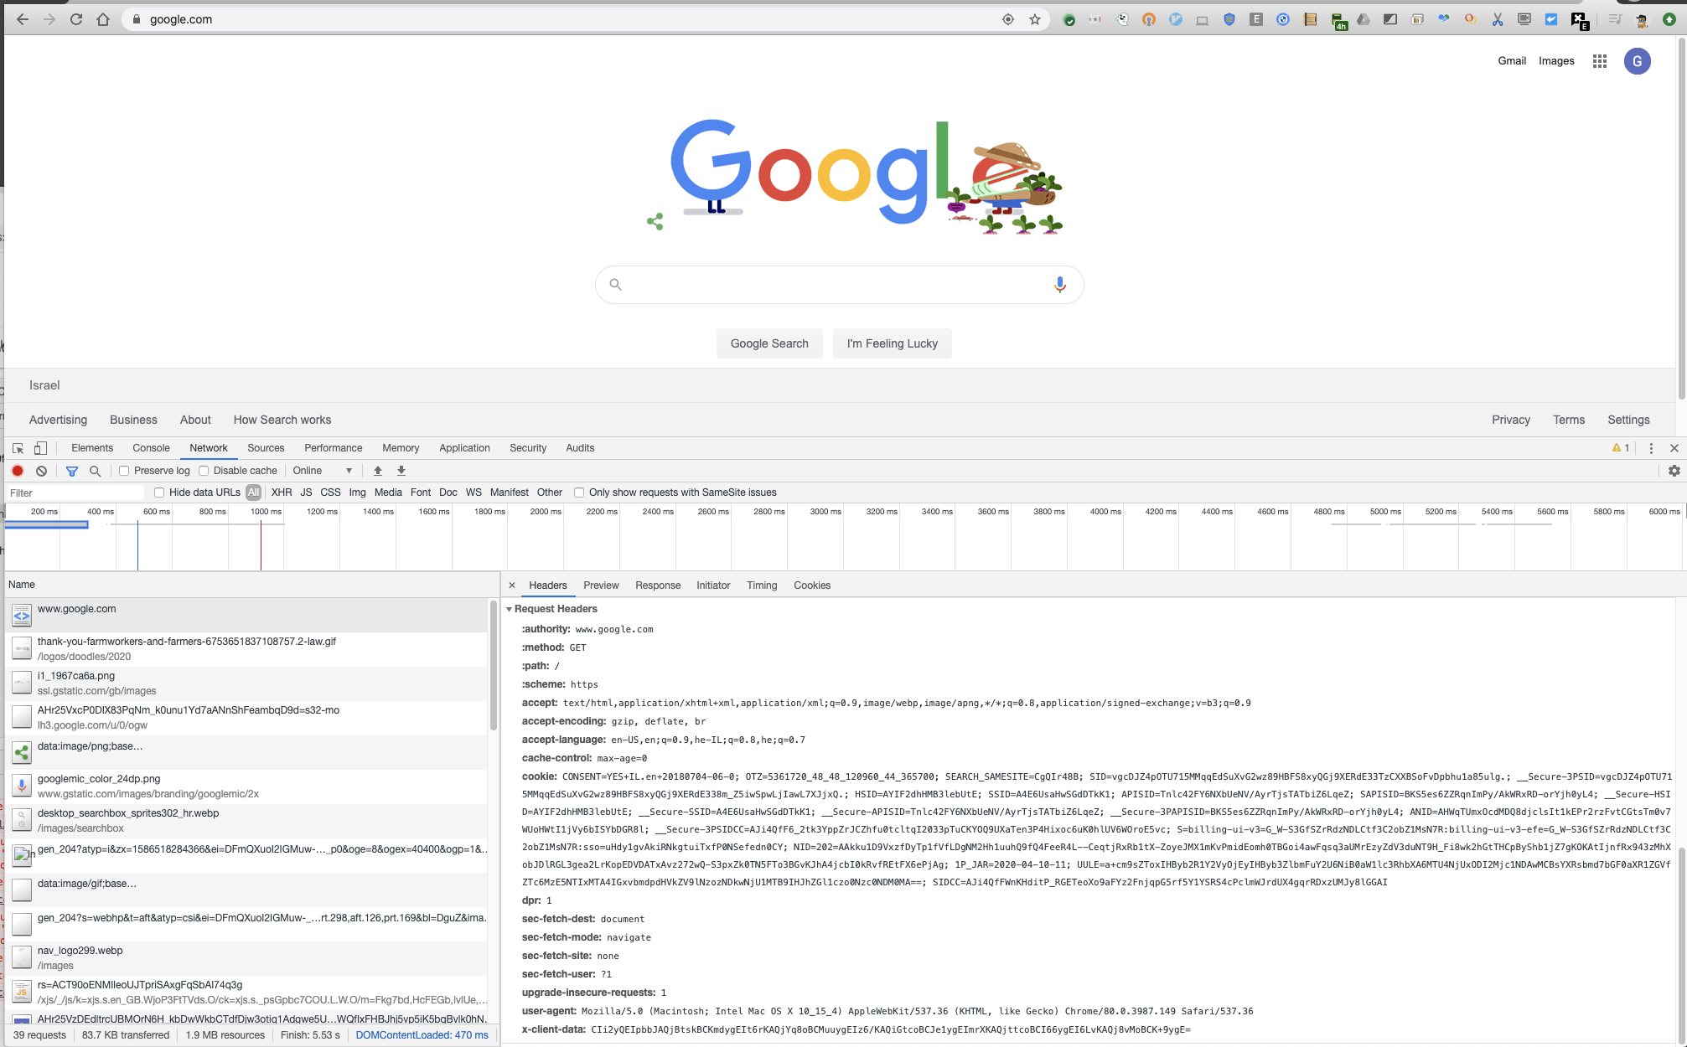
HTTP & REST
Each HTTP request is built with a set of headers and a body.
Every request will have a method header - which can be GET, POST, PUT, DELETE, HEAD, OPTIONS
Notes:
A request is commonly named after it’s ‘method’ value - “a GET request” or a “POST request”
When going to a specific url, the browser always does a ‘GET’ request to that url.
If the browser runs into resources it needs to download (like images, css, fonts, js) those are also retrieved using ‘GET’.
Other methods can be used with javascript code.

Slide 26
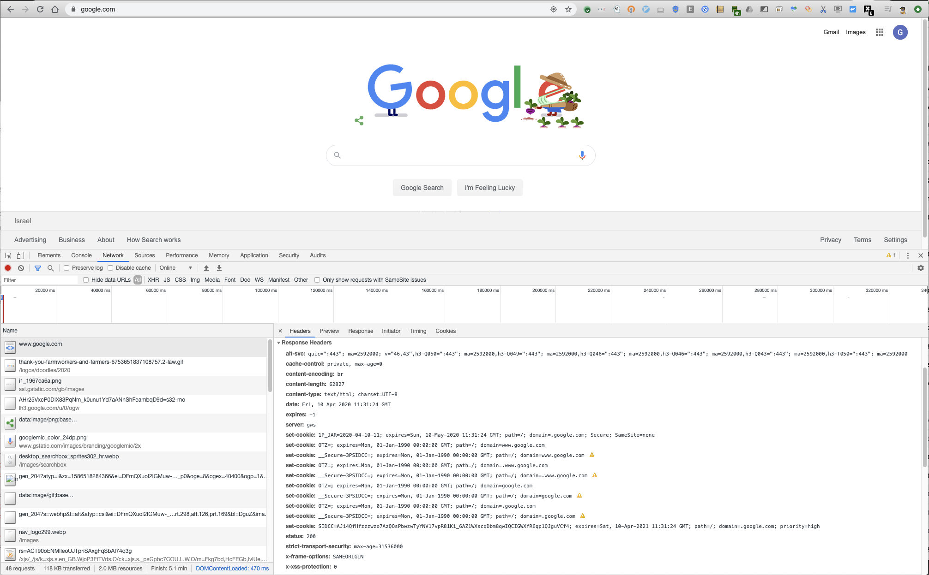
HTTP & REST
Responses will also have a set of headers, and usually a body.
Common response headers are:
status which tells us the status of the response. 2xx = OK 3xx = Redirect 4xx = Client Error 5xx = Server Error
content-type tells us how the browser should parse the response
Notes:
content-type - can be ‘text/css’, ‘text/html’, ‘application/json’, ‘application/js’, and more…
List of http status codes: https://en.wikipedia.org/wiki/List_of_HTTP_status_codes
You can add any headers you want, even if they don’t exist - the convention is to prefix them with ‘X-’

Slide 27
Cookies
Cookies are pieces of information a web server can use to maintain state on the user’s machine.
Every time the browser sends an http request, it checks if it has a cookie registered for that domain, and if it does, it sends it in the request as well.
In the server’s response the cookie can be overridden - using the set-cookie header.
Common uses of cookies are to save user preferences for a specific site, what they added to a shopping cart, authentication status, etc.
NOTE: This comes with a lot of security risks! Stealing a cookie can mean stealing an online identity!

Slide 28
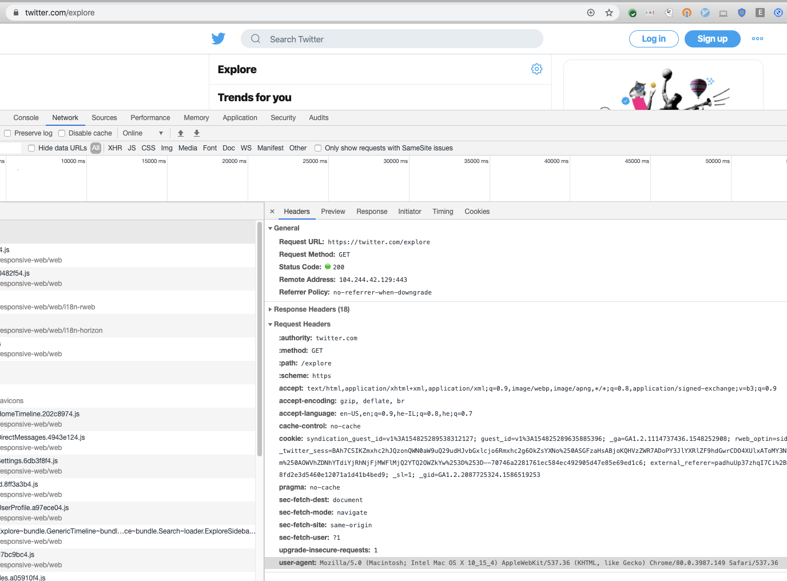
Cookies (sample request)
Notes:
Navigating to ‘https://twitter.com’ sends my twitter cookie in the request headers.
If you look closely, you’ll see ‘_twitter_sess’ in there… If this is stolen, i’m in trouble ;)

Slide 29
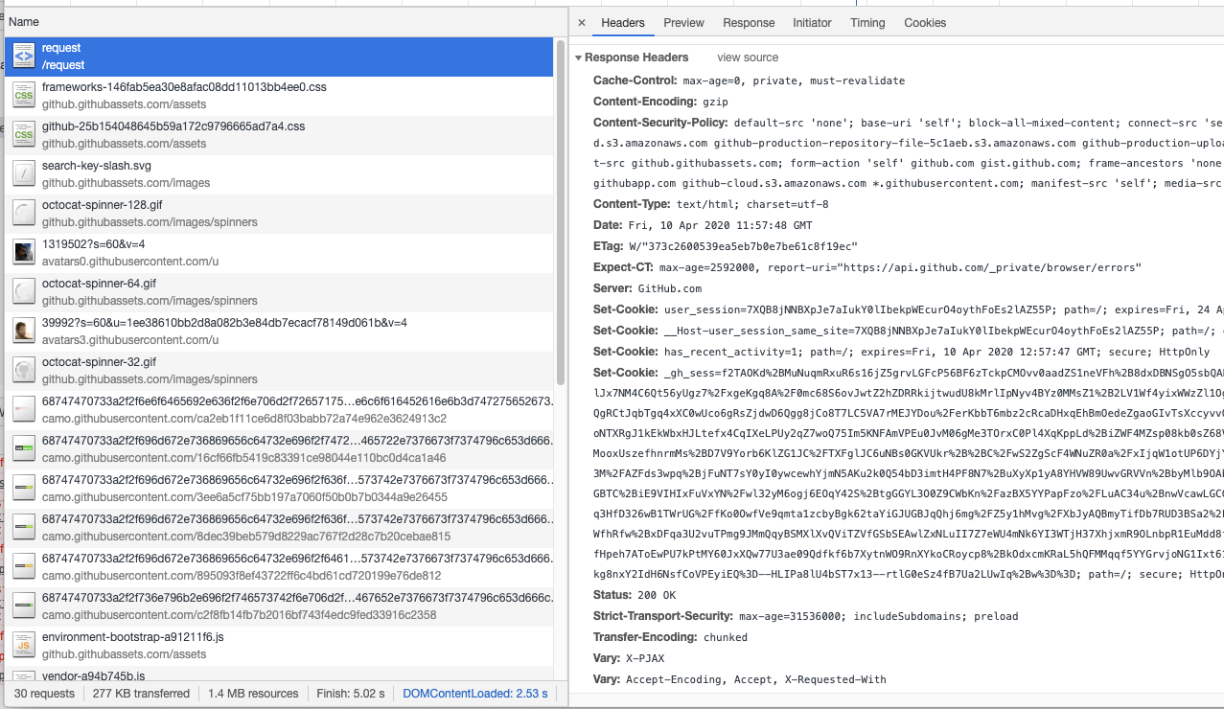
Cookies (sample response)
Notes:
In this response you see the ‘set-cookie’ header which overrides the cookie we have for this domain.

Slide 30

More cool things the browser can do...
Work offline
Push notifications (mobile and desktop)
Camera and Microphone capabilities
Offline storage
Vibration
Touch gestures
Detect location and device motion
Speech recognition
Payments
Notes:
There’s a lot more features browsers can do!
Not all are fully supported across browsers, but worth checking the full list:
https://whatwebcando.today/

Slide 31
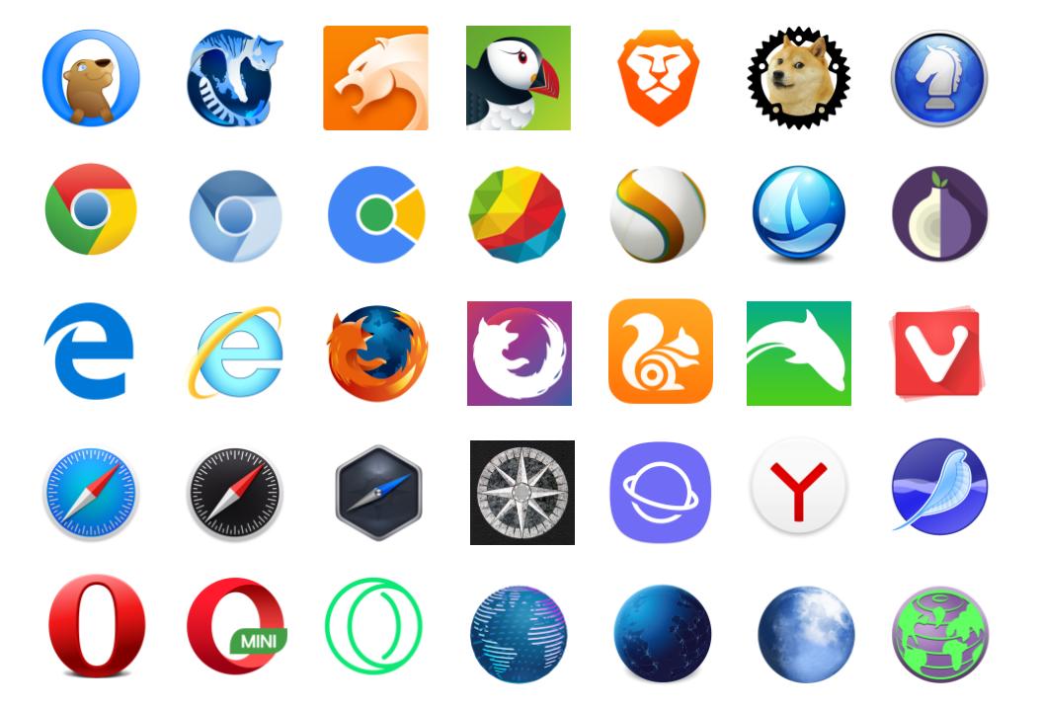
The Wild Wild West...
Notes:
This is just a partial list of browsers -
Opera, FireFox, IE, Edge, Brave, Chrome, Safari, Tor, Yandex, Samsung mobile, etc…
All of these browsers try to match each other’s behaviors, and new features, but you can’t count on it.
A common piece of advice -
Where ever possible, you should try to make use of frameworks that are well maintained by known figures in the community and battle-tested in production by other people/companies.
This is easy to see when looking at their github page, or reading blog posts on the subject. Try to see which company is behind this.
A good site to check which browsers support which features: caniuse.com

Slide 32
Frameworks & Libraries

Slide 33
Frameworks & libraries
Libraries offer various classes and methods/functions to make specific tasks easier.
i.e.: jQuery is a very popular framework that aimed to make many tasks like DOM manipulation, CSS animations, event handling and ajax much easier, while maintaining a common api that would solve different browsers’ specifications.
Frameworks define the application design, and call the users code in a specific way.
A very popular design paradigm is MVC - Model-View-Controller. Splitting the app into different layers to improve code quality and maintainability. Some examples of this are: React, AngularJS, EmberJS, Vue
CSS specific frameworks exist as well - Bootstrap is a very popular option.
They solve common problems with layout as well, and make many complex styling issues much simpler.
Notes:
jQuery is very old, and was really revolutionary at the time!!
Browsers were very different back then, and creating a site that behaved properly in IE and Firefox the same was very difficult.

Slide 34
Why ?
Make many complicated tasks easier (i.e. XMLHttpRequest → $.ajax() )
Make code much more maintainable and easier to test. (by splitting to layers - MVC)
Solve many cross browser issues.
Performance optimizations (i.e.: Virtual DOM)
Security, security, security!

Slide 35

Notes:
A very popular open source framework by facebook.
It’s more of a library for creating UI components.

Slide 36
React Overview
React is a UI Component library. Each component has it’s view, internal state and logic.
Components are classes that inherit from React.Component
JSX is used to represent a component’s template (the view).
Each component handles its own events and updates its own state. Updating the component’s UI is only done by changing its state object (setState).
Once a state is changed, React builds the new DOM in memory (also known as ‘virtual DOM’) and compares it to the previous DOM - Only when there are differences, React will re-render the component.

Slide 37
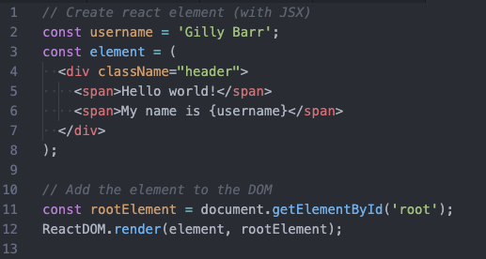
React Overview
The simplest way to create a react component is to just define a JSX template as a variable.
String interpolation in JSX is done by inserting brackets with an expression inside.
JSX is very similar to html - but:
All attributes are camelCase (no hyphens)
class was renamed to className
After compiling, JSX elements are converted into calls to React.createElement()

Slide 38
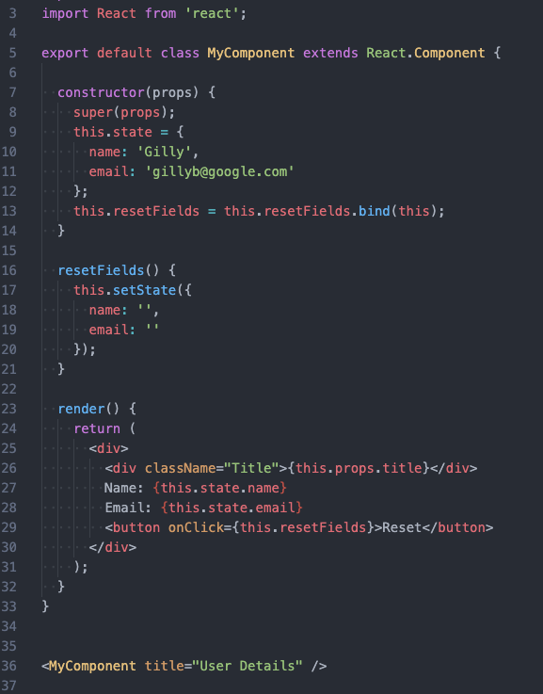
React Overview
State & Props
State can only be initialized in a component’s constructor. Update state using this.setState() React will then re-render the component if necessary. You can inject into your component parameters using the props object.
Notes:
A few important things happening here:
State is initialized in the constructor
resetFields() calls ‘setState’, and we can update whichever parameters we want in the state. We don’t have to update the “whole” state
We are calling ‘bind’ on ‘resetFields’ in the constructor, so that ‘this’ is bound to this class, and not to the ‘window’ object when being called in the browser.
You can see at the bottom how we would call this component - the attributes we add to the component tag will be passed into the ‘props’ object we get in the constructor.

Slide 39
React Overview
Component Lifecycle
We might want to invoke code after the component is rendered to the screen, or before it is removed. There are two hooks for this: componentDidMount() - Called after render (once) componentWillUnmount() - Called before being removed from the DOM A few more useful (but less common) events: componentDidUpdate(prevProps) - called after a component was updated with new props. shouldComponentUpdate(nextProps, nextState) - called when the props/state were changed, and you can change define if this requires a re-render.

Slide 40
Demo!

Slide 41
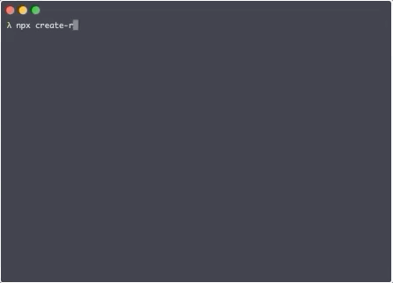
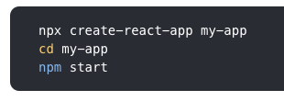
Building a react app
Prerequisites & Installation
Install nodejs Install “Create React App”

Slide 42
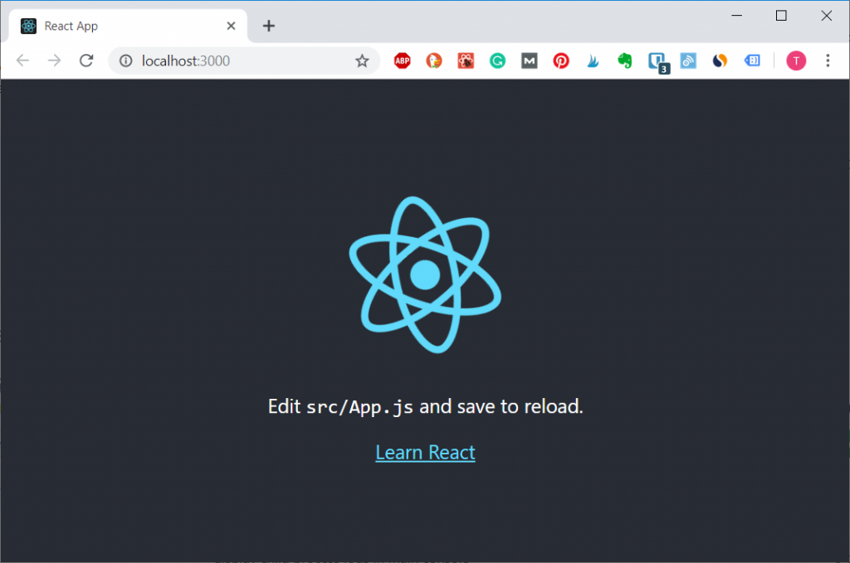
Building a react app
You’re ready to start!
Go to http://localhost:3000 and you should see this:

Slide 43
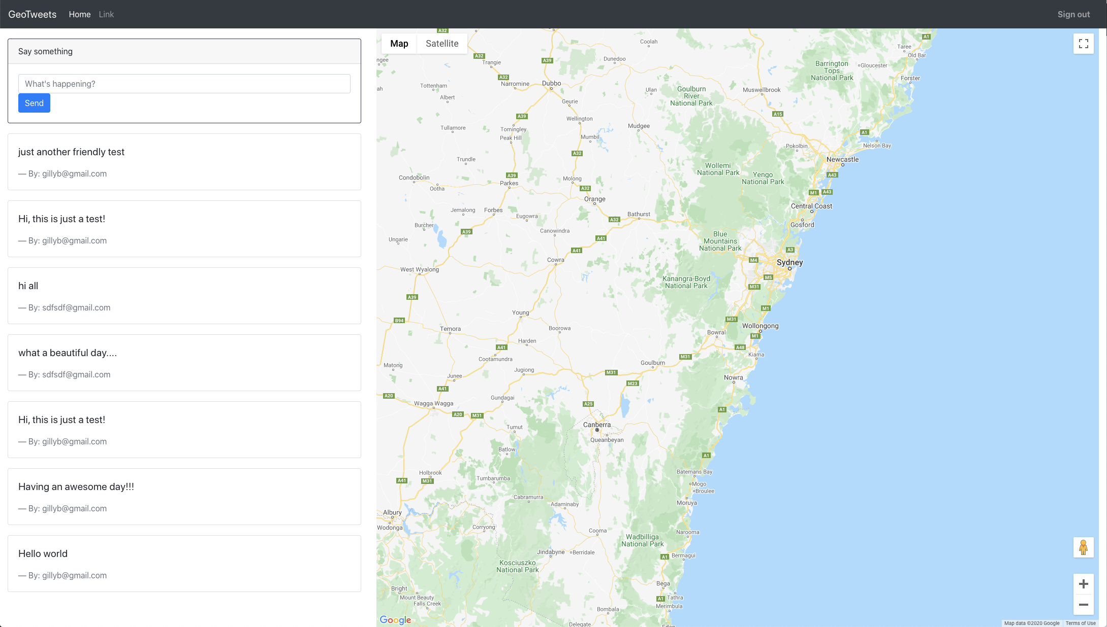
Building a react app
Demo repo
https://github.com/gillyb/tau-workshop

Slide 44
DevTools

Slide 45
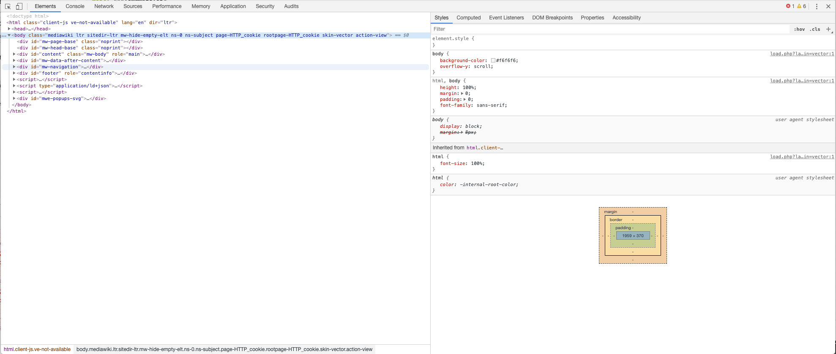
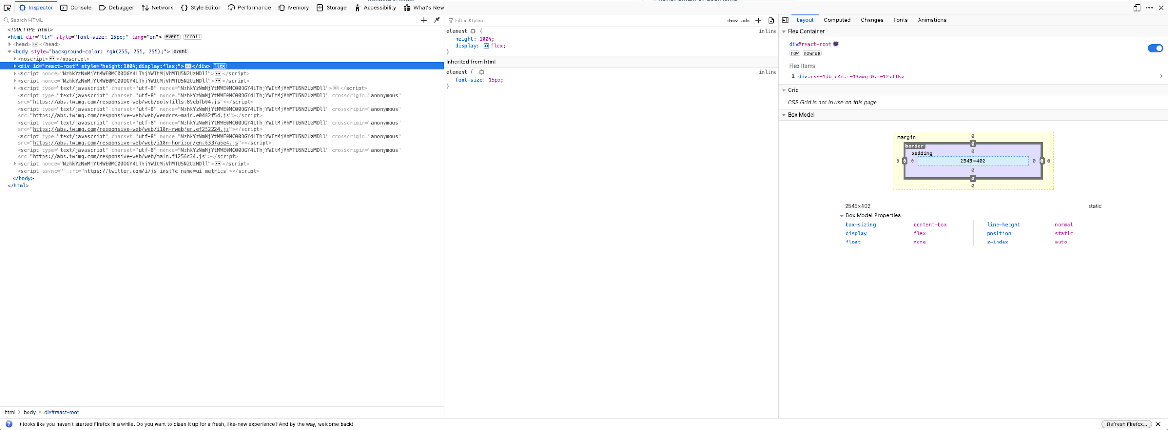
DevTools ❤️
DevTools (or FireBug) is our window to the client side code.
Everything that happens on the client side we can see and modify to our needs!
DevTools is a front-end developers best friend!
Fun Fact: DevTools (and FireBug) is just another webapp written in javascript.

Slide 46
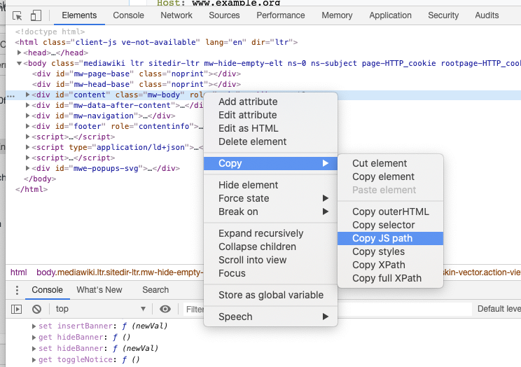
DevTools tips and tricks
Accessing elements in the console:
$0 to access highlighted element
Right click > Copy > ‘Copy Selector’ or ‘Copy JS Path’ ‘Copy JS Path’ will copy to your clipboard a command like this: document.querySelector(‘#content’)
Note: The DOM displayed here is how the browser interpreted our code, not necessarily our exact code.
Notes:
The note - if we have errors in our html, then the browser will probably fix them, but not necessarily how we intend.

Slide 47
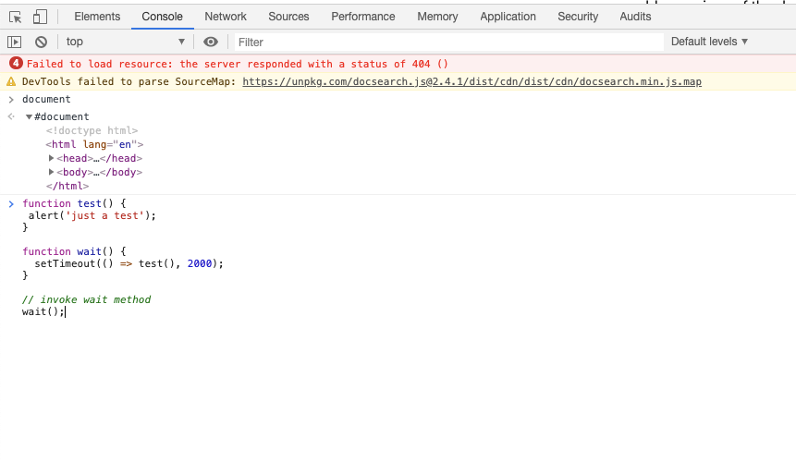
DevTools tips and tricks
Use the Console tab to run anything!
Directly type or paste js code into it and hit ‘enter’.
You can just type a name of an object, and it will show all of its properties.
You will see here errors thrown in your app, and output from calls to console.log(‘some log information’);

Slide 48
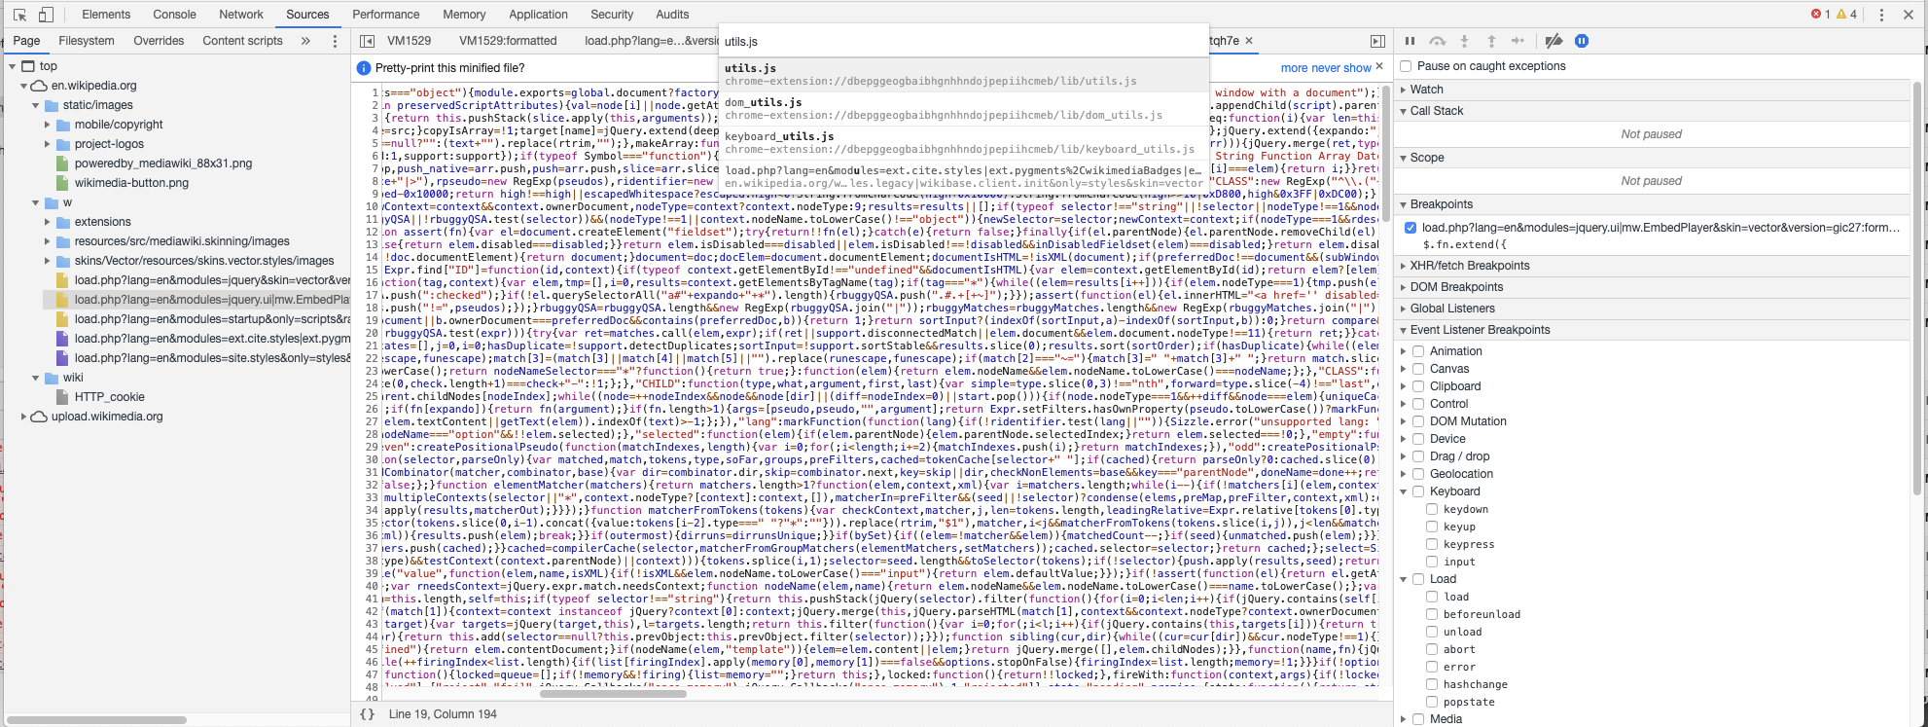
DevTools tips and tricks
Navigating and debugging your code:
Command + P to search for specific files (js/css)
Click on the brackets button “{}” to parse/indent the code.
Click on the line numbers to place breakpoints.
Right click on the line number to create a conditional breakpoint!

Slide 49
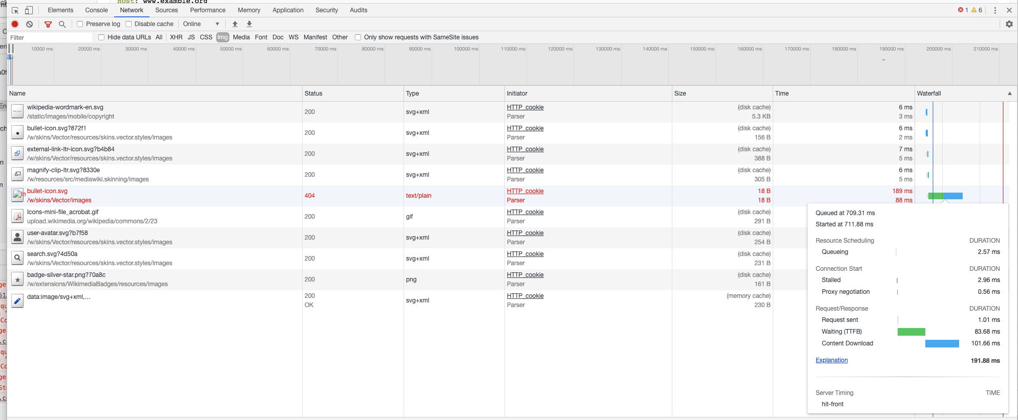
DevTools tips and tricks
Navigating the Network tab:
Use the filters (and search) to find what you need. (‘XHR’ is short for XMLHttpRequest and will show you all ajax requests)
Send a request again by: Right click > Copy > ‘Copy as fetch’ then paste this into the console.
Hover over ‘waterfall’ section to get performance metrics of specific request.

Slide 50
A few more things I didn’t mention
Security | I did mention this, but didn’t go into much detail, and there’s always more to learn. Be careful :)
Accessibility | There’s a ton of people in the world with various disabilities that require them to use screen readers. HTML has many attributes (“aria”) that tell the readers how to interpret the page.
Performance | How to optimize your site for slower bandwidth - Reducing image sizes, lazy loading, server side rendering, etc.
Mobile | Talked a little about using media queries to style for mobile, but mobile devices come with more features that we might need to modify our site to use - i.e.: touch gestures
Testing | Writing quality code requires various testing methods - from unit tests to system tests (end-to-end tests).

Slide 51
Thank You
;

